Slide 1
CS508-Data Mining
Chidambaram Crushev
Shahriar Dipon
Erick Ortiz
Data Miners 1
Final Report

Slide 2
Overview
The data set contains laboratory values of blood donors and Hepatitis C patients.
The attributes contained demographic values like age, sex, blood components, etc.
Problem statement - A patient has Hepatitis or Not(Binary)? Also, which stage of Hepatitis a patient has(Multiclass)?
The dataset is obtained from https://archive.ics.uci.edu/ml/datasets/HCV+data

Slide 3
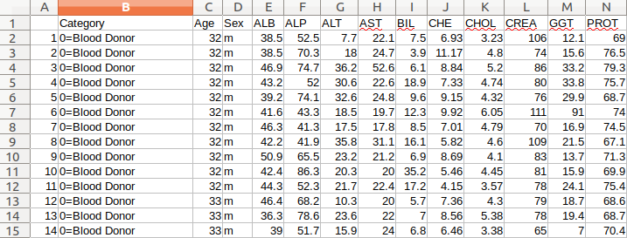
DataSet Sample

Slide 4
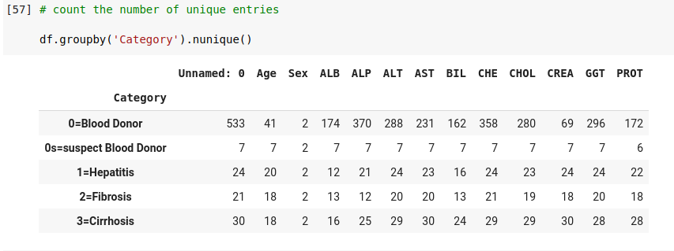
Data Preparation (Total data instances 615)
Step 1:
Replace the null values by the mean of the column.
Step 2:
The sex column “male & female” have been assigned the integers values 1 and 0

Slide 5
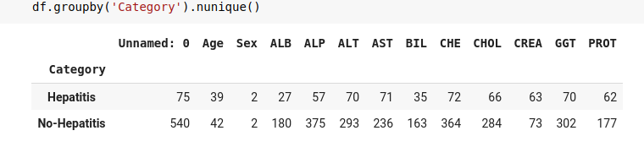
Data Preparation (Total data instances 615)
Step 3:
Since it is a Binary classification problem, the target labels “0=Blood Donor”, “0s- suspect blood donor” is given the target label “0”. The rest of the target labels “1=Hepatitis, 2= Fibrosis, 3=Cirrhosis” is assigned the target label “1”

Slide 6
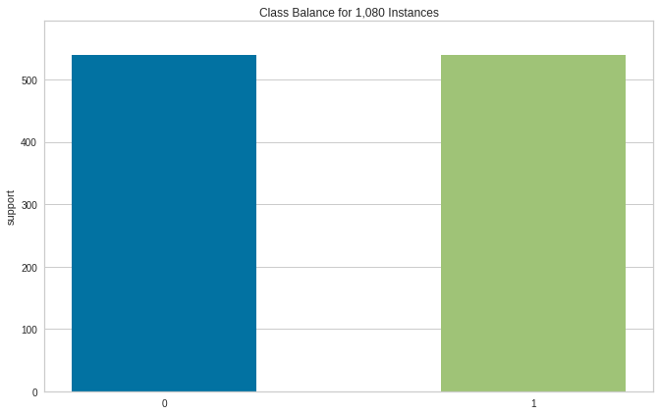
Data Preparation (Step 3- Before applying SMOTE algorithm)
(After applying SMOTE algorithm)
Class instances balanced with 1080 instances.

Slide 7
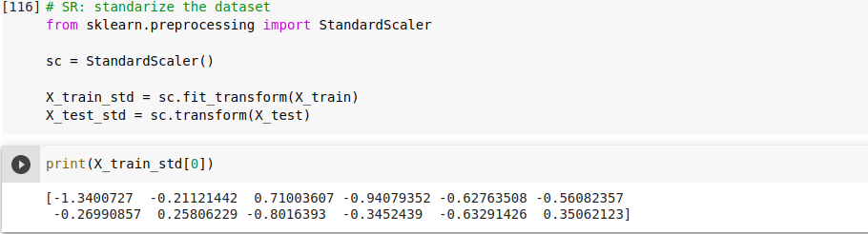
Data Preparation (Step 4)
Standardize the attributes using standard scalar.

Slide 8
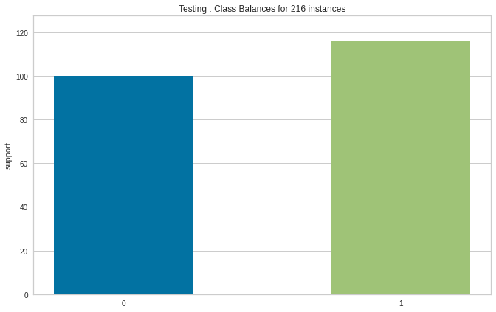
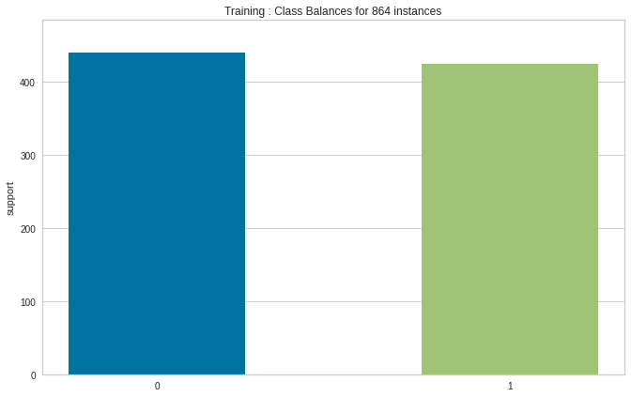
Data Preparation (Step 5)
Split the dataset into training and testing in the ratio of 4:1

Slide 9
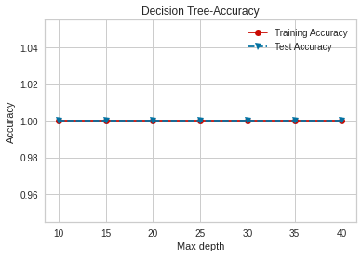
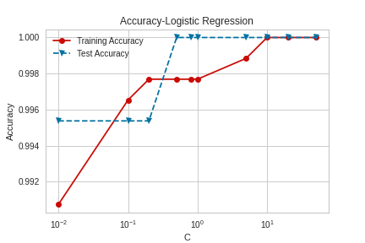
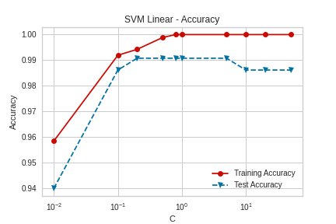
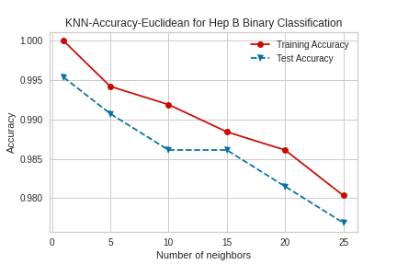
Binary Classification - Accuracy

Slide 10
Binary Classification - Accuracy Contd.
From the diagram of logistic regression, that our best value for regularization strength, C, was at 0.2. After 0.2, the model starts to overfit. At our preferred regularization strength, the accuracy value is quite high- above 99%.
For Support Vector Machine (SVM), the accuracy of our model was high. However, as the regularization parameter went over 1, the test accuracy starts to decrease. For the test dataset, the model starts fluctuating instead of converging to a minima.
For our oversampled datasets, k Nearest Neighbor (knn) performed as well as other algorithms. However, for our synthetic dataset, the optimum k value stayed low at 2.
We have used both ‘gini’ and ‘entropy’ for our criterion in using Decision Tree. We have seen that either criteria returns good results for binary classification.

Slide 11
Binary Classification - Ensemble method
Implemented ensemble methods to increase the accuracy further for the models.
All the classifiers performed well, so the ensemble also performed well.
Accuracy: 0.99 (+/- 0.02) [Logistic Regression]
Accuracy: 0.99 (+/- 0.02) [Support Vector Machine]
Accuracy: 0.99 (+/- 0.02) [K Nearest Neighbor]
Accuracy: 0.97 (+/- 0.07) [Decision Tree]
Accuracy: 0.99 (+/- 0.03) [Ensemble]

Slide 12
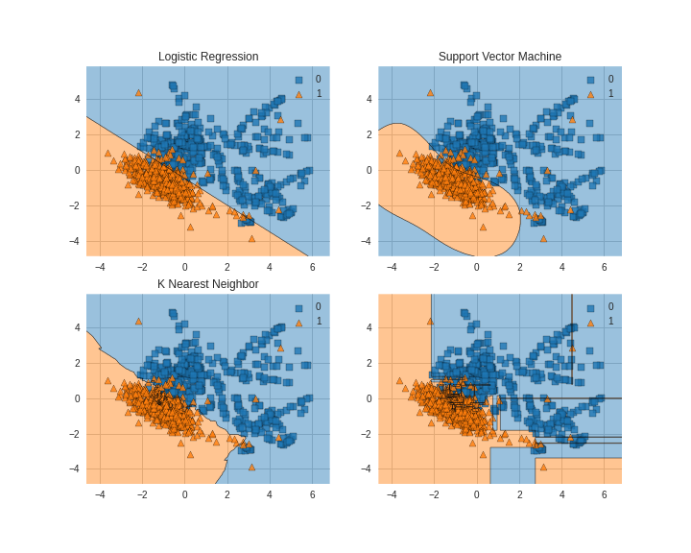
Binary Classification - Decision boundary
To generate decision boundaries, the data frame is reduced to two dimensions by using PCA analysis.
We can see that the decision boundaries do a good job at separating the class labels
Decision tree

Slide 13
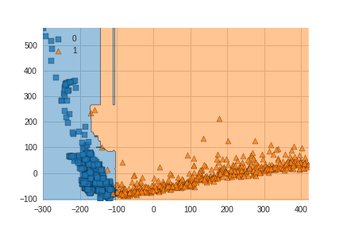
Binary Classification - Random Forest
To reduce the trade-off of overfitting in decision trees, we have implemented Random Forest Classifier. For Random Forest Classifier, our accuracy was 99.5%.

Slide 14
Binary Classification - Bagging
In our oversampled dataset for binary classification, we have performed bagging with replacement.
We have used the Decision Tree algorithm as our only estimator for bagging. Our returned result after running the bagging on test data is 100% and the Out of Bag Score is 99.7 %

Slide 15
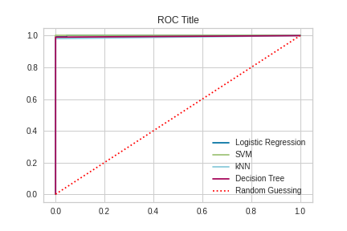
Binary Classification - ROC curve
We see from the ROC Curve that our models perform better than random sampling.

Slide 16
Multi-class classification
For multi-class classification, the target labels are [0= Blood donor, 0s= suspect blood donor, 1=Hepatitis, 2= Fibrosis, 3= Cirrhosis]
Various stages of hepatitis are “1=Hepatitis, 2=Fibrosis, 3=Cirrhosis”.
Blood donors target labels “0=Blood donor, 0s= suspect blood donor.”

Slide 17
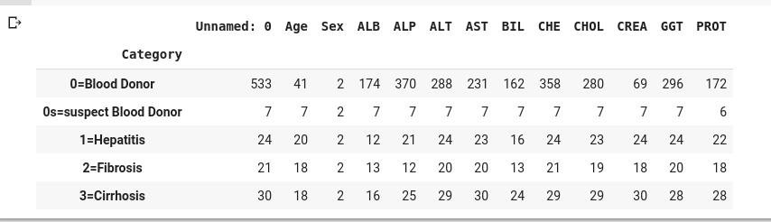
Data Preparation (Total data instances 615)
Same steps same as the Binary problem
Before SMOTE algorithm:
Addressing the class imbalance problem - Apply SMOTE algorithm.

Slide 18
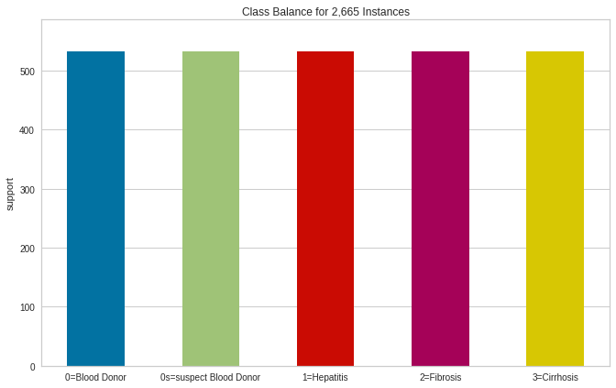
Data Preparation (After applying SMOTE algorithm)
Each class - 533 instances

Slide 19
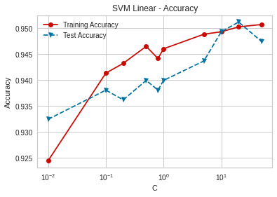
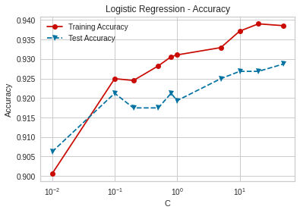
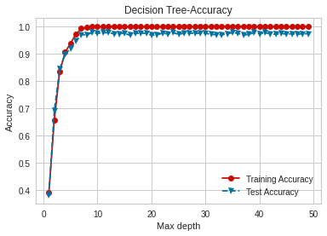
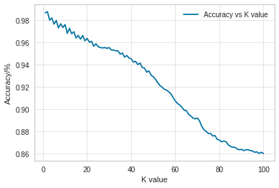
Multi-class Classification - Accuracy

Slide 20
Multi-class Classification - Accuracy Contd.
For multi-class classification using logistic regression, the best value for regularization strength, C was 50. At C = 50, the accuracy value is higher - around 92%.
For SVM models, the accuracy is high. However, as the regularization parameter went over 10, the model started to overfit. So, the optimum regularization strength value is 10 because after C=10 the model starts to overfit.
For Knn, The optimum k value stayed low at 2. The accuracy was high and found to be 0.987609(K=2) for the oversampled dataset .
From the diagram of decision tree, we could see that the testing accuracy(0.97749) is high for maxDepth-value 13 and then, it remained consistent for maxDepth values >13. So, the optimum maxDepth value is 13.

Slide 21
Multi-class Classification - Ensemble method
Implemented ensemble methods to increase the accuracy further for the models.
All the classifiers performed well, so the ensemble also performed well.
Accuracy: 0.92 (+/- 0.03) [Logistic Regression]
Accuracy: 0.99 (+/- 0.02) [Support Vector Machine]
Accuracy: 0.98 (+/- 0.01) [K Nearest Neighbor]
Accuracy: 0.98 (+/- 0.02) [Decision Tree]
Accuracy: 0.99 (+/- 0.03) [Ensemble]

Slide 22
Multi-class Classification - Bagging
In our oversampled dataset for multi-class classification, we have performed bagging with replacement.
We have used the Decision Tree algorithm as our only estimator for bagging.
Our returned result after running the bagging on test data is 98.3% and the Out of Bag Score is 96.7 %. This is a visible drop from the results we had for binary classification.

Slide 23
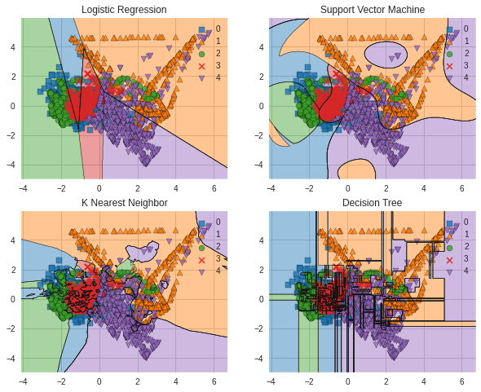
Multi-class Classification - Decision boundary
To generate decision boundaries, the data frame is reduced to two dimensions by using PCA analysis.
Label | Target - class
0 | 0= Blood Donor
1 | 0s = Suspect Blood Donor
2 | 1= Hepatitis
3 | 2= Fibrosis
4 | 3= Cirrhosis

Slide 24
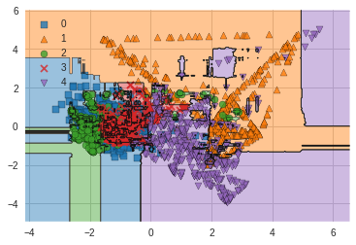
Multi-class Classification - Random Forest
The random forest accuracy score is found to be 72.6%
For our synthetic dataset, this is a serious setback.
The generated dataset were within a small margin within the multidimensional, this low accuracy is rational.

Slide 25
Conclusion
We have implemented traditional machine learning algorithms on a classification dataset and tried to elaborate the behaviour of the algorithms.
Our studies have its shortcomings. We could not show performance metrics for multiclass classification due to time constraint.
Also, our accuracy for some algorithms in multiclass algorithms were low. Feedback from domain experts could have made the results better.
In addition, small instances of target labels in the original data set remained a major constraint. Collecting more data for the original data set can improve our results.

Slide 26
Thank you!

